Slide 1
UNIT-3
Knowledge and Reasoning

Slide 2
Knowledge
Humans are best at understanding, reasoning, and interpreting knowledge.
Human knows things, which is knowledge and as per their knowledge they perform various actions in the real world.
But how machines do all these things comes under knowledge representation and reasoning.
What is Knowledge?
  It is some set of patterns and associations derived from data or information that helps in making decisions and resolves problems that may be related to any day-to-day life or some complex problems.

Slide 3
Reasoning
A systematic reasoning process is required when we try to relate the events to the outcomes or to arrive at judgements.
Reasoning is the way we conclude on different aspects of problems based on the available knowledge representation.
Logic plays an important role in the reasoning process.
So, logic is the one that makes the knowlledge representative.

Slide 4
Knowledge representation and reasoning
Knowledge representation and reasoning (KR, KRR) is the part of Artificial intelligence which concerned with AI agents thinking and how thinking contributes to intelligent behavior of agents.
Knowledge representation is not just storing data into some database, but it also enables an intelligent machine to learn from that knowledge and experiences so that it can behave intelligently like a human.
The different kinds of knowledge that need to be represented in AI include:
Objects, Events, Performance, Facts, Meta-Knowledge, Knowledge-base

Slide 5
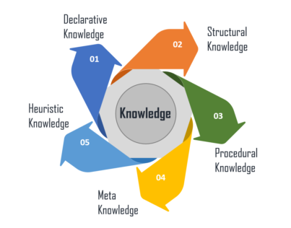
Different Types of Knowledge

Slide 6
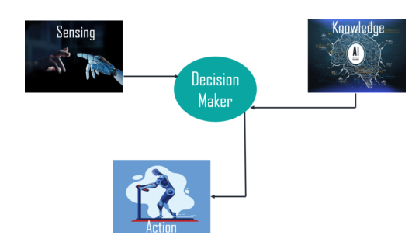
What is the Relation between Knowledge & Intelligence?

Slide 7
Approaches to Knowledge Representation in AI
There are different approaches to knowledge representation such as:
1. Simple Relational Knowledge
2. Inheritable Knowledge
3. Inferential Knowledge

Slide 8
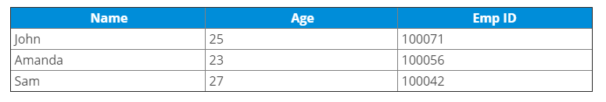
Simple Relational Knowledge
It is the simplest way of storing facts which uses the relational method.
Here, all the facts about a set of the object are set out systematically in columns.
Also, this approach of knowledge representation is famous in database systems where the relationship between different entities is represented.
Thus, there is little opportunity for inference.
Example:

Slide 9
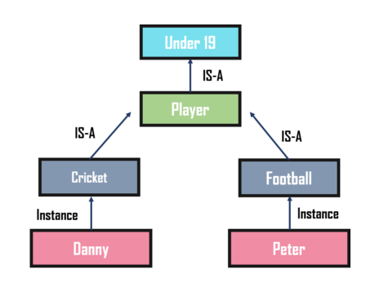
Inheritable Knowledge
In the inheritable knowledge approach, all data must be stored into a hierarchy of classes and should be arranged in a generalized form or a hierarchal manner.
Also, this approach contains inheritable knowledge which shows a relation between instance and class, and it is called instance relation.
In this approach, objects and values are represented in Boxed nodes.
Example:

Slide 10
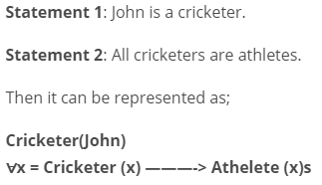
Inferential Knowledge
The inferential knowledge approach represents knowledge in the form of formal logic.
Thus, it can be used to derive more facts.
Also, it guarantees correctness.
Example:

Slide 11
Issues in Knowledge Representation
Attributes
Relationship among the attributes
Granularity
Representation of objects as sets
Selectin of correct structure

Slide 12
Important Attributed:
Any attribute of objects so basic that they occur in almost every problem domain?
There are two attributed “instance” and “isa”(One entity type might be a subtype of another), that are general significance.
These attributes are important because they support property inheritance.
Relationship among attributes:
Any important relationship that exists among object attributed?
The attributes we use to describe objects are themselves entities that we represent.

Slide 13
The relationship between the attributes of an object, independent of specific knowledge they encode, may hold properties like:
  Inverse — This is about consistency check, while a value is added to one attribute. The entities are related to each other in many different ways.
  Existence in an isa hierarchy — This is about generalization-specification, like, classes of objects and specialized subsets of those classes, there are attributes and specialization of attributes. For example, the attribute height is a specialization of general attribute physical-size which is, in turn, a specialization of physical-attribute. These generalization-specialization relationships are important for attributes because they support inheritance.
  Technique for reasoning about values — This is about reasoning values of attributes not given explicitly. Several kinds of information are used in reasoning, like, height: must be in a unit of length, Age: of a person cannot be greater than the age of person’s parents. The values are often specified when a knowledge base is created.
  Single valued attributes — This is about a specific attribute that is guaranteed to take a unique value. For example, a baseball player can at time have only a single height and be a member of only one team. KR systems take different approaches to provide support for single valued attributes.

Slide 14
Choosing Granularity:
At what level of detail should the knowledge be represented?
Regardless of the KR formalism, it is necessary to know:
  At what level should the knowledge be represented and what are the primitives?
Should there be a small number or should there be a large number of low-level primitives or High-level facts.
High-level facts may not be adequate for inference while Low-level primitives may require a lot of storage.
Set of objects:
How should sets of objects be represented?
There are certain properties of objects that are true as member of a set but not as individual;
The reason to represent sets of objects is: if a property is true for all or most elements of a set, then it is more efficient to associate it once with the set rather than to associate it explicitly with every elements of the set.

Slide 15
Finding Right structure:
Given a large amount of knowledge stored in a database, how can relevant parts are accessed when they are needed?
This is about access to right structure for describing a particular situation.
This requires, selecting an initial structure and then revising the choice.
While doing so, it is necessary to solve following problems:
  How to perform an initial selection of the most appropriate structure.
  How to fill in appropriate details from the current situations.
  How to find a better structure if the one chosen initially turns out not to be appropriate.
  What to do if none of the available structures is appropriate.
  When to create and remember a new structure.

Slide 16
Knowledge-Based Agent
An intelligent agent needs knowledge about the real world for taking decisions and reasoning to act efficiently.
Knowledge-based agents are those agents who have the capability of maintaining an internal state of knowledge, reason over that knowledge, update their knowledge after observations and take actions.
These agents can represent the world with some formal representation and act intelligently.
Knowledge-based agents are composed of two main parts:
  Knowledge-base and
  Inference system.

Slide 17
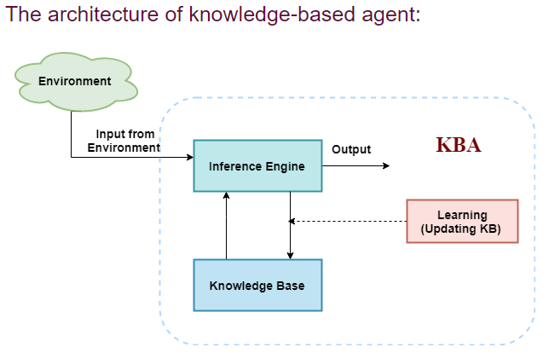
A knowledge-based agent must able to do the following:
  An agent should be able to represent states, actions, etc.
  An agent Should be able to incorporate new percepts
  An agent can update the internal representation of the world
  An agent can deduce the internal representation of the world
  An agent can deduce appropriate actions.

Slide 18
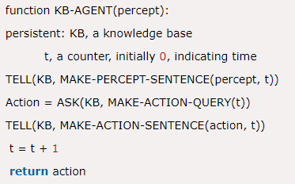
Operations Performed by KBA
Following are three operations which are performed by KBA in order to show the intelligent behavior:
  TELL: This operation tells the knowledge base what it perceives from the environment.
  ASK: This operation asks the knowledge base what action it should perform.
  Perform: It performs the selected action.
A generic knowledge-based agent:

Slide 19
Various levels of knowledge-based agent:
A knowledge-based agent can be viewed at different levels which are given below:
1. Knowledge level
Knowledge level is the first level of knowledge-based agent, and in this level, we need to specify what the agent knows, and what the agent goals are. With these specifications, we can fix its behavior. For example, suppose an automated taxi agent needs to go from a station A to station B, and he knows the way from A to B, so this comes at the knowledge level.
2. Logical level:
At this level, we understand that how the knowledge representation of knowledge is stored. At this level, sentences are encoded into different logics. At the logical level, an encoding of knowledge into logical sentences occurs. At the logical level we can expect to the automated taxi agent to reach to the destination B.

Slide 20
3. Implementation level:
This is the physical representation of logic and knowledge. At the implementation level agent perform actions as per logical and knowledge level. At this level, an automated taxi agent actually implement his knowledge and logic so that he can reach to the destination.A knowledge-based agent can be viewed at different levels which are given below:

Slide 21
Approaches to designing a knowledge-based agent
There are mainly two approaches to build a knowledge-based agent:
  Declarative approach: We can create a knowledge-based agent by initializing with an empty knowledge base and telling the agent all the sentences with which we want to start with. This approach is called Declarative approach.
  Procedural approach: In the procedural approach, we directly encode desired behavior as a program code. Which means we just need to write a program that already encodes the desired behavior or agent.
However, in the real world, a successful agent can be built by combining both declarative and procedural approaches, and declarative knowledge can often be compiled into more efficient procedural code.

Slide 22
Logic Basics
logic deals with study of principles of reasoning.
Here, we study about how logic is built,or how the logical representation help in the process of decisions.
logic involves syntax, semantics and inference procedure.
Syntax: there is variety of ways to represent syntax. it is not a concern but it is the way an agent builds a base so that reasoning plays an important parrt.
Semantics: it deals with the meaning in sentential form, it can either be true or false.
Logical inferring: there is a notion of truth that is to be maintained. even it needs to have the property of completeness.

Slide 23
Propositional logic-syntax,semantics and inferences
Propositional logic (PL) is the most simple logic that is concerned with the propositions and their relationship.
It is a mathematical model that provides reasoning regarding the logical value of an expression.
A proposition is a declarative statement which is either true or false but not both.
Example:
  It is Sunday.
  The Sun rises from West (False proposition)
  3+3= 7(False proposition)
  5 is a prime number.

Slide 24
Syntax of propositional logic
The syntax of propositional logic defines the allowable sentences for the knowledge representation.
There are two types of Propositions:
  Atomic Propositions (simple)
  Compound propositions
Atomic Proposition: It consists of a single propositional symbol. This symbol esentially represents if the proposition can be true or false.
Example:
a) 2+2 is 4, it is an atomic proposition as it is a true fact.
b) "The Sun is cold" is also a proposition as it is a false fact.

Slide 25
Compound proposition: Compound propositions are constructed by combining simpler or atomic propositions, using parenthesis and logical connectives.
Example:
a) "It is raining today, and street is wet."
b) "Ankit is a doctor, and his clinic is in Mumbai."
Logical Connectives:
Logical connectives are used to connect two simpler propositions or representing a sentence logically.
We can create compound propositions with the help of logical connectives.

Slide 26
There are mainly five connectives, which are given as follows:
Negation: A sentence such as ~or ¬ P is called negation of P. A literal can be either Positive literal or negative literal.
Conjunction: A sentence which has ∧ connective such as, P ∧ Q is called a conjunction.
Example: Rohan is intelligent and hardworking. It can be written as,
P= Rohan is intelligent,
Q= Rohan is hardworking. → P∧ Q.
Disjunction: A sentence which has ∨ connective, such as P ∨ Q. is called disjunction, where P and Q are the propositions.
Example: "Ritika is a doctor or Engineer",
Here P= Ritika is Doctor. Q= Ritika is Doctor, so we can write it as P ∨ Q.

Slide 27
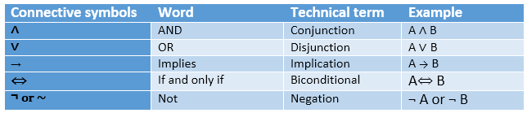
Implication: A sentence such as P → Q, is called an implication. Implications are also known as if-then rules. It can be represented as
If it is raining, then the street is wet.
Let P= It is raining, and Q= Street is wet, so it is represented as P → Q
Biconditional: A sentence such as P⇔ Q is a Biconditional sentence, example If I am breathing, then I am alive
P= I am breathing, Q= I am alive, it can be represented as P ⇔ Q.
Following is the summarized table for Propositional Logic Connectives:

Slide 28
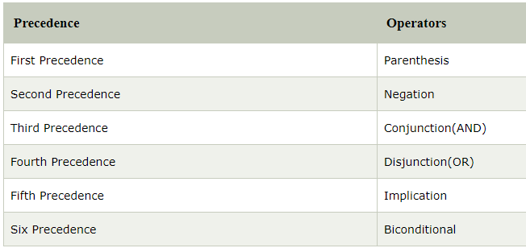

Slide 29
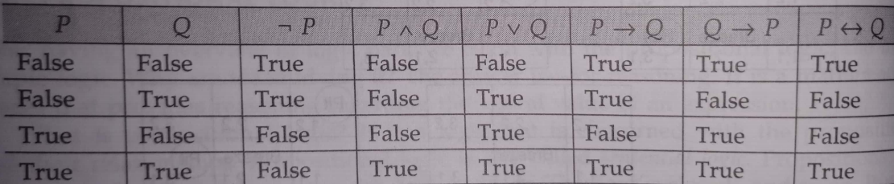
Semantics of propositional logic
It tells about the rules to determine the truth of a sentence.
The model comprising a number of propositions actually defines the truth value.
with 2 propositional symbols the model will be 2^2, with 3 it will be 2^3.

Slide 30
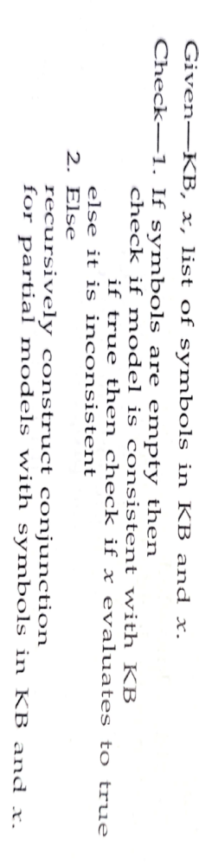
Inference of propositional logic
Generating the conclusions from evidence and facts is termed as Inference.
When comes to inference, we need to enumerate the models.
The number of propositions playing part in it directly hampers the efficiency.
The values where KB is true, and thus, the value of x is true indicate inferring.
Given a sentence n, the approach for deciding entailment is based on recursive enumeration. The approach is:

Slide 31
Some Concepts
Tautology: It states that the sentence is true if it is true in all models.It is also called validity.
Contradiction: Here, the proposition is always false.
Satisfiability: A sentence or a proposition is satisfiable if it is true for some model.
To understand the relation between validity and satisfiability:
  Assume that a sentence x is valid.
  To prove that x is valid, we need to prove that ~x is not valid.
  we can state that, x I= y iff sentence (x^~y) is unsatisfiable.
  Proving y from x by checking the unsatisfiability is Proof by refutation or contradiction.

Slide 32
Reasoning patterns in propositional logic
Here, we use and apply the basic rules in order to derive chains of conclusions to get the outcome or the target.
These basic rules are also called patterns of inference.
Two most commonly used rules are modes ponens and and-elimination.
  Modus ponens is represented as follows:
  ɑ -> β, ɑ l-> β
    the rule states that when any sentence is in the form of ɑ -> β, and ɑ is given, then we can infer β.
  In and-elimination , the rule is represented as
  ɑ1^ɑ2^ɑ3^ɑn l->ɑi
    It states that from conjunctions, it is possible to infer any conjunction.
These rules are actually the ones that eliminate the need for generating the models.
When these rules are applied, they generate sound(correct) inferences.

Slide 33
Resolution
Resolution discuss about completeness.
Resolution is a single inference rule, which gives a complete inference algorithm when coupled with complete search algorithms.
Any search algorithms, that is complete and applies the resolution rule can derive any conclusion that is entailed in KB.
suppose if x proposition is true, it is not possible to have resolution to generate XvY, but can determine whether it is true or not.
This is referred to as refutation completeness.
Resolution is not ly applied to disjunctions but to conjection forms also called conjunctive normal form (CNF).

Slide 34
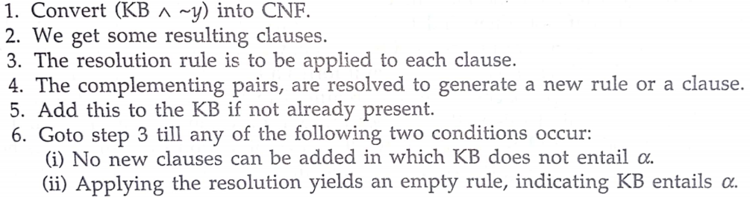
Resolution Algorithm

Slide 35
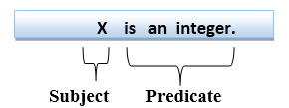
Predicate logic
In propositional logic, we can only represent the facts, which are either true or false. It is not sufficient to represent the complex sentences or natural language statements.
The propositional logic has very limited expressive power.
So, we required some more powerful logic, such as Predicate logic.
It is also known as First-order logic. (more expressive)
First-order logic statements can be divided into two parts:
  Subject: Subject is the main part of the statement.
  Predicate: A predicate can be defined as a relation, which binds two atoms together in a statement.
Consider the statement: "x is an integer.", it consists of two parts, the first part x is the subject of the statement and second part "is an integer," is known as a predicate.

Slide 36
Syntax and Semantics
First-order logic (like natural language) does not only assume that the world contains facts like propositional logic but also assumes the following things in the world:
  Objects: A, B, people, numbers, colors, wars, theories, squares, pits, wumpus, ......
  Relations: It can be unary relation such as: red, round, is adjacent, or n-any relation such as: the sister of, brother of, has color, comes between
  Function: Father of, best friend, third inning of, end of, ......
As a natural language, first-order logic also has two main parts:
  Syntax
  Semantics
The syntax of FOL determines which collection of symbols is a logical expression in first-order logic. The basic syntactic elements of first-order logic are symbols.
We write statements in short-hand notation in FOL.

Slide 37
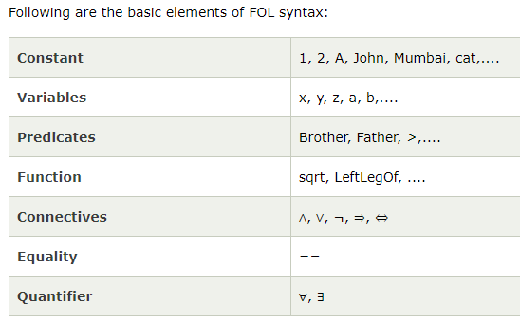

Slide 38
For example,
“The car is red”
      here ‘car’ is the subject and ‘is red’ is the predicate.
While representing,
  R(x) ; where R is red and x is any object
A sentence can be an atomic sentence or sentence connected to each other.
Atomic sentences:
Atomic sentences are the most basic sentences of first-order logic. These sentences are formed from a predicate symbol followed by a parenthesis with a sequence of terms.
We can represent atomic sentences as Predicate (term1, term2, ......, term n).
Example: Ravi and Ajay are brothers: => Brothers(Ravi, Ajay).
Chinky is a cat: => cat (Chinky).

Slide 39
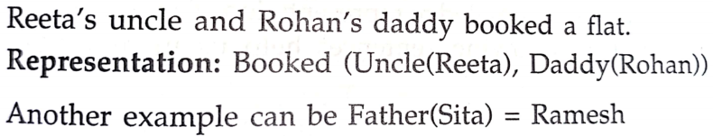
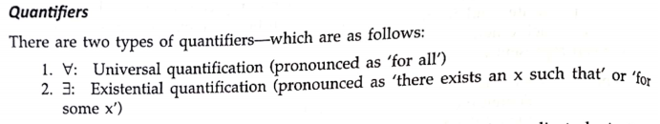
Complex Sentences:
Complex sentences are made by combining atomic sentences using connectives.

Slide 40
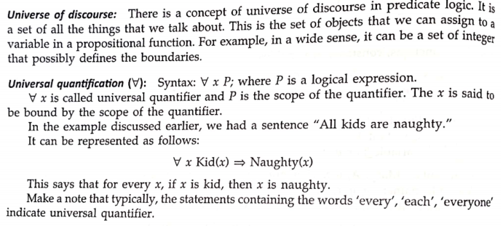

Slide 41
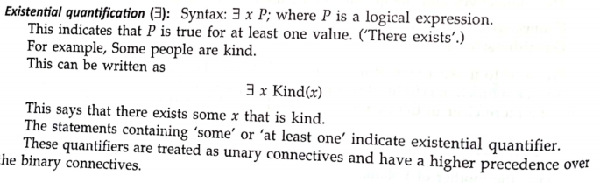

Slide 42
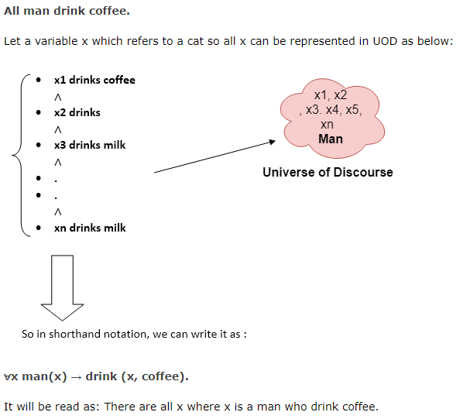
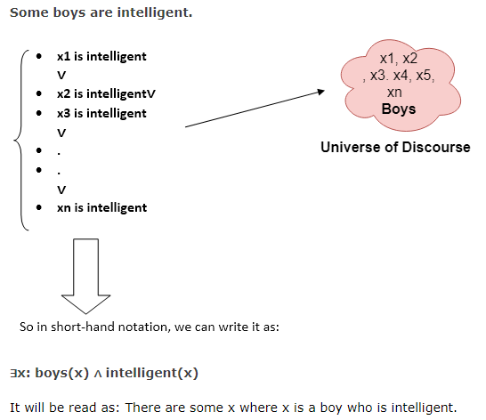

Slide 43
Inference in First-Order Logic
Inference in First-Order Logic is used to deduce new facts or sentences from existing sentences.
Example:
  Shyam is an engineer.
  All engineers are intelligent.
Here, intelligent and engineer are the classes. whereas, instance indicates the membership belonging to the class.
Instance(Shyam, Engineer) indicates the class membership.

Slide 44
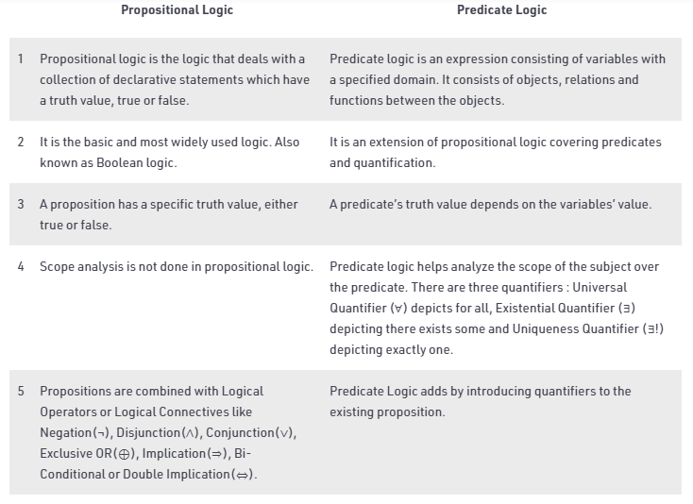
Comparison of predicate and propositional logic

Slide 45
Unification
Unification is a process of making two different logical atomic expressions identical by finding a substitution.
Unification depends on the substitution process.
The substitution variables are called Most General Unifier or MGU.
The UNIFY algorithm is used for unification, which takes two atomic sentences and returns a unifier for those sentences (If any exist).
It returns fail if the expressions do not match with each other.
Unification is a key component of all first-order inference algorithms.
Unification takes two literals as input and makes them identical using substitution.
  Let Ψ1 and Ψ2 be two atomic sentences and 𝜎 be a unifier such that, Ψ1𝜎 = Ψ2𝜎, then it can be expressed as UNIFY(Ψ1, Ψ2).

Slide 46
Example: Find the MGU for Unify{King(x), King(John)}
  Let Ψ1 = King(x), Ψ2 = King(John),
  Substitution θ = {John/x} is a unifier for these atoms and applying this substitution, and both expressions will be identical.
E.g. Let's say there are two different expressions, P(x, y), and P(a, f(z)).
  In this example, we need to make both above statements identical to each other.
  For this, we will perform the substitution.
  P(x, y)......... (i)
  P(a, f(z))......... (ii)
  Substitute x with a, and y with f(z) in the first expression, and it will be represented as a/x and f(z)/y.
  With both the substitutions, the first expression will be identical to the second expression and the substitution set will be: [a/x, f(z)/y].

Slide 47
Conditions for Unification:
Following are some basic conditions for unification:
  Predicate symbol must be same, atoms or expression with different predicate symbol can never be unified.
  Number of Arguments in both expressions must be identical.
  Unification will fail if there are two similar variables present in the same expression.

Slide 48
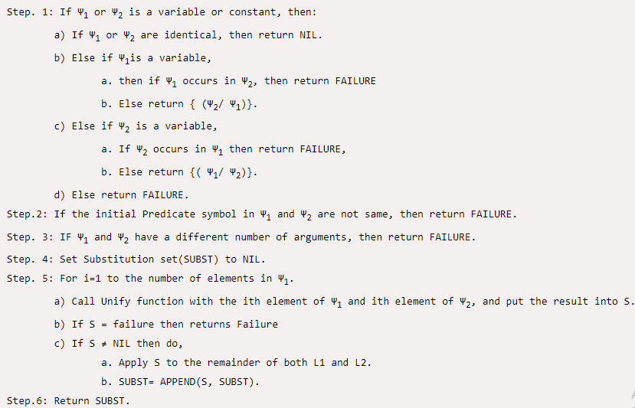
Unification Algorithm
Algorithm: Unify(Ψ1, Ψ2)

Slide 49
Implementation of the Algorithm
Step.1: Initialize the substitution set to be empty.
Step.2: Recursively unify atomic sentences:
a.Check for Identical expression match.
b.If one expression is a variable vi, and the other is a term ti which does not contain variable vi, then:
a.Substitute ti / vi in the existing substitutions
b.Add ti /vi to the substitution setlist.
c.If both the expressions are functions, then function name must be similar, and the number of arguments must be the same in both the expression.

Slide 50
1. Find the MGU of {p(f(a), g(Y)) and p(X, X)}
Sol:
S0 => Here, Ψ1 = p(f(a), g(Y)), and Ψ2 = p(X, X)
SUBST θ= {f(a) / X}
S1 => Ψ1 = p(f(a), g(Y)), and Ψ2 = p(f(a), f(a))
SUBST θ= {f(a) / g(y)}, Unification failed.
Unification is not possible for these expressions.
2. Find the MGU of {p(b, X, f(g(Z))) and p(Z, f(Y), f(Y))}
Sol:
Here, Ψ1 = p(b, X, f(g(Z))) , and Ψ2 = p(Z, f(Y), f(Y))
S0 => { p(b, X, f(g(Z))); p(Z, f(Y), f(Y))}
SUBST θ={b/Z}
S1 => { p(b, X, f(g(b))); p(b, f(Y), f(Y))}
SUBST θ={f(Y) /X}
S2 => { p(b, f(Y), f(g(b))); p(b, f(Y), f(Y))}
SUBST θ= {g(b) /Y}
S2 => { p(b, f(g(b)), f(g(b)); p(b, f(g(b)), f(g(b))} Unified Successfully.
And Unifier = { b/Z, f(Y) /X , g(b) /Y}.

Slide 51
UNIFY(knows(Richard, x), knows(Richard, John))
Sol:
Here, Ψ1 = knows(Richard, x), and
Ψ2 = knows(Richard, John)
S0 => { knows(Richard, x); knows(Richard, John)}
SUBST θ= {John/x}
S1 => { knows(Richard, John); knows(Richard, John)}, Successfully Unified.
Unifier: {John/x}.

Slide 52
Resolution in FOL
Resolution is a theorem proving technique that proceeds by building refutation proofs, i.e., proofs by contradictions.
It was invented by a Mathematician John Alan Robinson in the year 1965.
Resolution is used, if there are various statements are given, and we need to prove a conclusion of those statements.
Unification is a key concept in proofs by resolutions.
Resolution is a single inference rule which can efficiently operate on the conjunctive normal form or clausal form.
Clause: Disjunction of literals (an atomic sentence) is called a clause.
It is also known as a unit clause.

Slide 53

Conjunctive Normal Form: A sentence represented as a conjunction of clauses is said to be conjunctive normal form or CNF.
The resolution inference rule:
The resolution rule for first-order logic is simply a lifted version of the propositional rule.
Resolution can resolve two clauses if they contain complementary literals, which are assumed to be standardized apart so that they share no variables.
Where li and mj are complementary literals.
This rule is also called the binary resolution rule because it only resolves exactly two literals.

Slide 54
Example:
We can resolve two clauses which are given below:
[Animal (g(x) V Loves (f(x), x)] and [￢ Loves(a, b) V ￢Kills(a, b)]
  Where two complimentary literals are: Loves (f(x), x) and ￢ Loves (a, b)
  These literals can be unified with unifier θ= [a/f(x), and b/x] , and it will generate a resolvent clause:
  [Animal (g(x) V ￢ Kills(f(x), x)].

Slide 55
Steps for Resolution
Conversion of facts into first-order logic.
Convert FOL statements into CNF
Negate the statement which needs to prove (proof by contradiction)
Draw resolution graph (unification).
To better understand all the above steps, we will take an example in which we will apply resolution.

Slide 56
Example:
John likes all kind of food.
Apple and vegetable are food
Anything anyone eats and not killed is food.
Anil eats peanuts and still alive
Harry eats everything that Anil eats.
Prove by resolution that:
John likes peanuts.

Slide 57
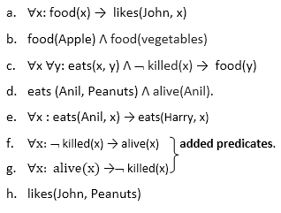
Step-1: Conversion of Facts into FOL
In the first step we will convert all the given statements into its first order logic.

Slide 58
Step-2: Conversion of FOL into CNF
In First order logic resolution, it is required to convert the FOL into CNF as CNF form makes easier for resolution proofs.
Eliminate all implication (→) and rewrite
  ∀x ¬ food(x) V likes(John, x)
  food(Apple) Λ food(vegetables)
  ∀x ∀y ¬ [eats(x, y) Λ ¬ killed(x)] V food(y)
  eats (Anil, Peanuts) Λ alive(Anil)
  ∀x ¬ eats(Anil, x) V eats(Harry, x)
  ∀x¬ [¬ killed(x) ] V alive(x)
  ∀x ¬ alive(x) V ¬ killed(x)
  likes(John, Peanuts).

Slide 59
Move negation (¬)inwards and rewrite
  ∀x ¬ food(x) V likes(John, x)
  food(Apple) Λ food(vegetables)
  ∀x ∀y ¬ eats(x, y) V killed(x) V food(y)
  eats (Anil, Peanuts) Λ alive(Anil)
  ∀x ¬ eats(Anil, x) V eats(Harry, x)
  ∀x ¬killed(x) ] V alive(x)
  ∀x ¬ alive(x) V ¬ killed(x)
  likes(John, Peanuts).
Rename variables or standardize variables
  ∀x ¬ food(x) V likes(John, x)
  food(Apple) Λ food(vegetables)
  ∀y ∀z ¬ eats(y, z) V killed(y) V food(z)
  eats (Anil, Peanuts) Λ alive(Anil)
  ∀w¬ eats(Anil, w) V eats(Harry, w)
  ∀g ¬killed(g) ] V alive(g)
  ∀k ¬ alive(k) V ¬ killed(k)
  likes(John, Peanuts).

Slide 60
Eliminate existential instantiation quantifier by elimination.
  In this step, we will eliminate existential quantifier ∃, and this process is known as Skolemization. But in this example problem since there is no existential quantifier so all the statements will remain same in this step.
Drop Universal quantifiers.
  In this step we will drop all universal quantifier since all the statements are not implicitly quantified so we don't need it.
      ¬ food(x) V likes(John, x)
      food(Apple)
      food(vegetables)
      ¬ eats(y, z) V killed(y) V food(z)
      eats (Anil, Peanuts)
      alive(Anil)
      ¬ eats(Anil, w) V eats(Harry, w)
      killed(g) V alive(g)
      ¬ alive(k) V ¬ killed(k)
      likes(John, Peanuts).

Slide 61
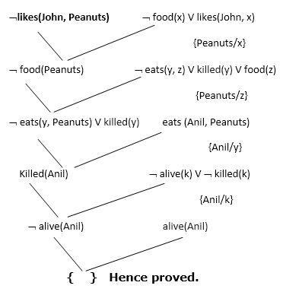
Distribute conjunction ∧ over disjunction ¬.
  This step will not make any change in this problem.
Step-3: Negate the statement to be proved
  In this statement, we will apply negation to the conclusion statements, which will be written as ¬likes(John, Peanuts)
Step-4: Draw Resolution graph:
  Now in this step, we will solve the problem by resolution tree using substitution. For the above problem, it will be given as follows:

Slide 62
Explanation of Resolution graph
In the first step of resolution graph, ¬likes(John, Peanuts) , and likes(John, x) get resolved(canceled) by substitution of {Peanuts/x}, and we are left with ¬ food(Peanuts)
In the second step of the resolution graph, ¬ food(Peanuts) , and food(z) get resolved (canceled) by substitution of { Peanuts/z}, and we are left with ¬ eats(y, Peanuts) V killed(y) .
In the third step of the resolution graph, ¬ eats(y, Peanuts) and eats (Anil, Peanuts) get resolved by substitution {Anil/y}, and we are left with Killed(Anil) .
In the fourth step of the resolution graph, Killed(Anil) and ¬ killed(k) get resolve by substitution {Anil/k}, and we are left with ¬ alive(Anil) .
In the last step of the resolution graph ¬ alive(Anil) and alive(Anil) get resolved.

Slide 63
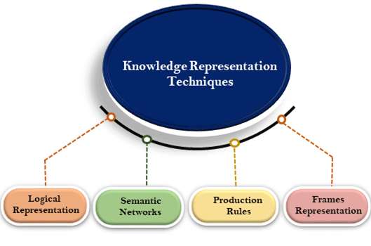
Knowledge representation

Slide 64
Knowledge representation using rules
Procedural Versus Declarative Knowledge
Logic Programming
Forward versus Backward Reasoning
Matching
  Indexing
  Matching with Variables
  Complex and Approximate Matching
  Conflict Resolution
    Preference Based on Rules
    Preference Based on Objects
    Preference Based on States

Slide 65
Procedural Versus Declarative Knowledge
The need for the representation of knowledge in terms of rules is finally to get the solution.
Two types of representation exist.
A declarative representation is one in which knowldge is specified, but the use to which that knowledge is to be put is not given.
A procedural representation is one in which the control information that is necessary to use the knowledge is considered to be embedded in the knowledge itself.

Slide 66
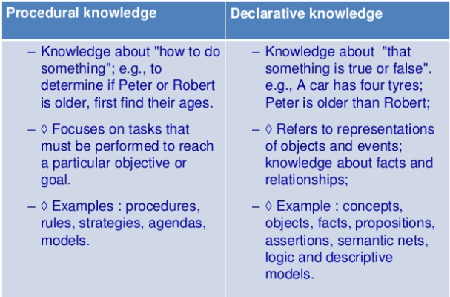

Slide 67
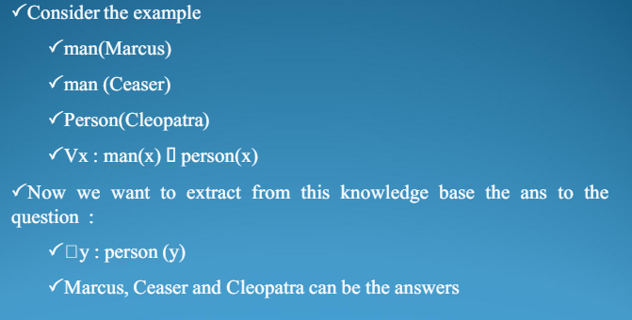
The real difference between the declarative and the procedural views of knowledge lies in where control information resides.
Example:

Slide 68
Logic Programming
Logic Programming is a programming language paradigm in which logical assertions are viewed as programs.
It comprises of facts(axioms) and rules(rules that determine goal).
PROLOG program is described as a series of logical assertions each of which is a Horn Clause.
Prolog program = {Horn Clauses}
  Horn clause: disjunction of literals of which at most one is positive literal
  p,¬pVq,and p->q are horn clauses.
Prolog program is decidable
Control structure:
Prolog interpreter = backward reasoning + depth-first with backtracking

Slide 69
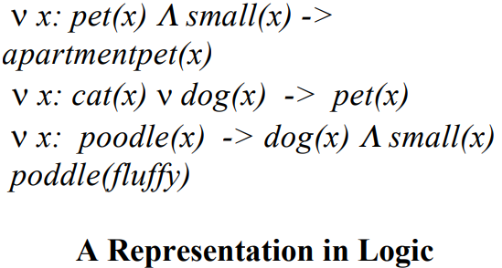

Slide 70
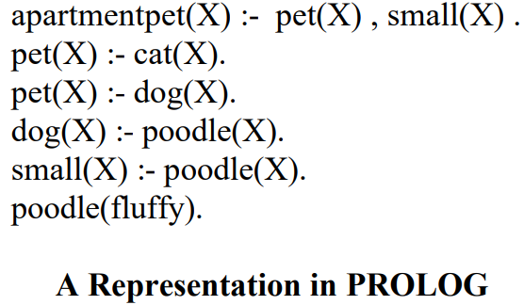

Slide 71
Forward versus Backward Reasoning
Forward: from the start states.
Backward: from the goal states.
Reason forward from the initial states:
  Begin building a tree of move sequences that might be solutions by starting with the initial configurations at the root of the tree. Generate the next level of the tree by finding all the rules whose left sides match the root node and using their right sides to create the new configurations. Continue until a confi guration that matches the goal state is generated.
Reason backward from the goal states:
  Begin building a tree of move sequences that might be solutions by starting with the goal configurations at the root of the tree. Generate the next level of the tree by finding all the rules whose right side match the root node.

Slide 72
Matching
How to extract from the entire collection of rules that can be applied at a given point?
=> Matching between current state and the precondition of the rules.
Indexing
One way to select applicable rules is to do a simple search through all the rules, comparing each one’s preconditions to the current state and extracting all the ones that match.
But there are two problems with this simple solution:
  It will be necessary to use a large number of rules. scanning through all of them at every step of the search would be hopelessly inefficient.
  It is not always immediately obvious whether a rule’s precondition’s are satisfied by a particular state

Slide 73
Approximate matching
Rules should be applied if their preconditions approximately match the current situation
Example: A speech-understanding program
  Rules: A description of a physical waveform to phones (a, e, …)
  Physical signal: differences in the way individuals speak, result of background noise, …
Women : i need your help.
ELIZA how can i help you?

Slide 74
Conflict resolution
The result of the matching process is a list of rules whose antecedents
  Preferences based on rules:
  • Specificity of rules
  • Physical order of rules
  –Preferences based on objects:
  • Importance of objects
  • Position of objects
  –Preferences based on action:
  • Evaluation of states

Slide 75
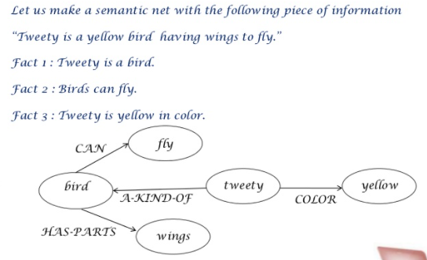
Semantic Networks
Semantic networks are graphs, with
  nodes representing objects and
  arcs representing relationships between objects.
The two most common types of relationships are
  Instance
  IS-A (Inheritance relation)
  HAS (Ownership relation)

Slide 76
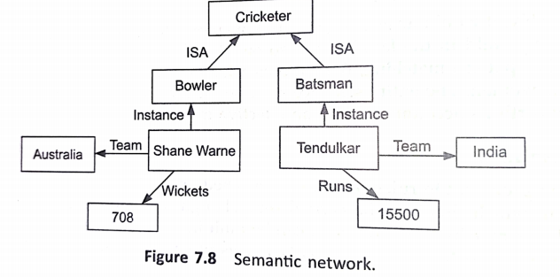
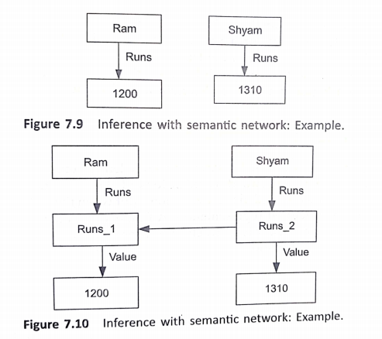

Slide 77
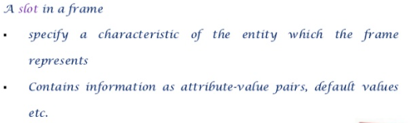
Frame Systems
It is an extensions of semantic networks.
A frame is a collection of attributes or slots.
Representation of frames:
Tendulkar
Instance: Batsman
Runs: 15500
Team: India

Slide 78
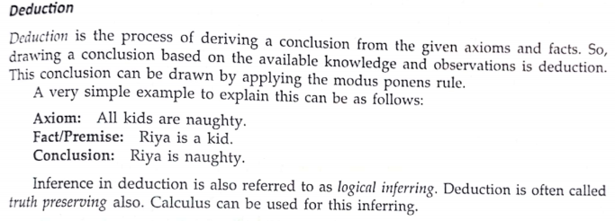
Inferences
It is a mechanism by which reasoning takes place.
Basic types are
  Deduction
  Induction
  Abduction

Slide 79
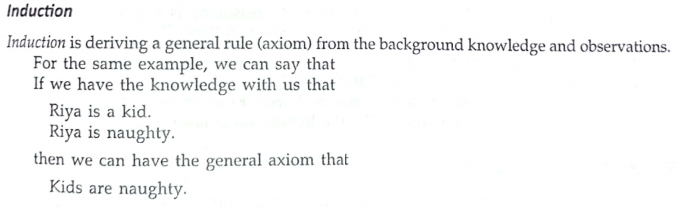
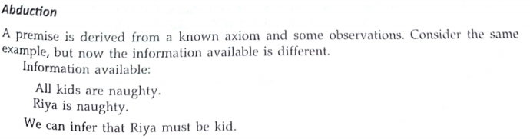

Slide 80
Uncertain Knowledge and Reasoning-Methods
Uncertainty
    Let action At = leave for airport t minutes before flight
    Will At get me there on time?
  Problems:
    1) partial observability (road state, other drivers’ plans, etc.)
    2) noisy sensors (traffic reports)
    3) uncertainty in action outcomes (flat tire, etc.)
    4) immense complexity of modelling and predicting traffic
  Hence a purely logical approach either
    1) risks falsehood: “A25 will get me there on time”
    or
    2) A1440 leads to conclusions that are too weak for decision making:

Slide 81
How To Deal With Uncertainty
Implicit methods:
Ignore uncertainty as much as possible
Build procedures that are robust to uncertainty
This is the approach in the planning methods studied so far
(e.g.monitoring and replanning)
Explicit methods:
Build a model of the world that describes the uncertainty (about the system’s state, dynamics, sensors, model)
Reason about the effect of actions given in the model

Slide 82
Methods for Handling Uncertainty
Default reasoning
  Nonmonotonic logic: Allow the retraction of default beliefs if they prove to be false
Rule-based methods
  Certainty factors (Mycin): propagate simple models of belief through causal or diagnostic rules
Evidential reasoning
  Dempster-Shafer theory: Bel(P) is a measure of the evidence for P; Bel(¬P) is a measure of the evidence against P; together they define a belief interval (lower and upper bounds on confidence)
Fuzzy reasoning
  Fuzzy sets: How well does an object satisfy a vague property?
  Fuzzy logic: “How true” is a logical statement?

Slide 83
Decision making with uncertainty
Rational behavior:
  For each possible action, identify the possible outcomes
  Compute the probability of each outcome
  Compute the utility of each outcome
  Compute the probability-weighted (expected) utility over possible outcomes for each action
  Select the action with the highest expected utility (principle of Maximum Expected Utility)

Slide 84
Probability
A well-known and well-understood framework for dealing with uncertainty
Has a clear semantics
Provides principled answers for:
– Combining evidence
– Predictive and diagnostic reasoning
– Incorporation of new evidence
• Can be learned from data
Intuitive to human experts (arguably?)

Slide 85
Bayesian Probability and Belief Network
We use probability to describe uncertainty due to:
– Laziness: failure to enumerate exceptions, qualifications etc.
– Ignorance: lack of relevant facts, initial conditions etc.
– True randomness? Quantum effects? ...
Probability can be interpreted from two views 1. Subjective and 2.Objective
Bayesian or subjective probabilities - relate propositions to one’s current state of knowledge.
– E.g. P(A(25)| no reported accident) = 0.1
These are not assertions about the world / absolute truth
Beliefs change with new evidence:
– E.g. P(A(25)| no reported accident, 5am) = 0.2
Bayesian probability is viewed as an extension of logic that enables reasoning with uncertain statements.

Slide 86
Conditional Probability
The basic statements in the Bayesian framework talk about conditional probabilities.
– P(A|B) is the belief in event A given that event B is known with certainty.
P(A|B)=P(A and B)/P(B)
If it is rewritten as,
P(A ∧ B) = P(A|B)P(B) = P(B|A)P(A)
– Note: we often write P(A, B) as a shorthand for P(A ∧ B)
This called Product Rule.

Slide 87

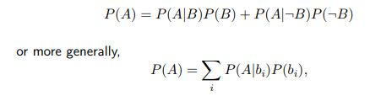
Bayes Rule
Bayes rule is another alternative formulation of the product rule:
It is used to infer the probability of hypothesis under observed data or evidence. (bayesian inference).
The complete probability formula states that:
where bi form a set of exhaustive and mutually exclusive events.

Slide 88
Bayesian inference
  Use probability theory and information about independence
  Reason diagnostically (from evidence (effects) to conclusions (causes)) or causally (from causes to effects)
Bayesian networks or belief network
  Compact representation of probability distribution over a set of propositional random variables
  Take advantage of independence relationships

Slide 89
We can define a Bayesian network as:
  "A Bayesian network is a probabilistic graphical model which represents a set of variables and their conditional dependencies using a directed acyclic graph."
It is also called a Bayes network, belief network, decision network, or Bayesian model.
Bayesian networks are probabilistic, because these networks are built from a probability distribution, and also use probability theory for prediction and anomaly detection.
Real world applications are probabilistic in nature, and to represent the relationship between multiple events, we need a Bayesian network.
It can also be used in various tasks including prediction, anomaly detection, diagnostics, automated insight, reasoning, time series prediction, and decision making under uncertainty.

Slide 90
Bayesian Network can be used for building models from data and experts opinions, and it consists of two parts:
  Directed Acyclic Graph
  Table of conditional probabilities.
The generalized form of Bayesian network that represents and solve decision problems under uncertain knowledge is known as an Influence diagram.
A Bayesian network graph is made up of nodes and Arcs (directed links), where:
  Each node corresponds to the random variables, and a variable can be continuous or discrete.
  Arc or directed arrows represent the causal relationship or conditional probabilities between random variables. These directed links or arrows connect the pair of nodes in the graph.
  These links represent that one node directly influence the other node, and if there is no directed link that means that nodes are independent with each other

Slide 91
Bayesian network is based on Joint probability distribution and conditional probability.
Joint probability distribution:
If we have variables x1, x2, x3,....., xn, then the probabilities of a different combination of x1, x2, x3.. xn, are known as Joint probability distribution.
P[x1, x2, x3,....., xn], it can be written as the following way in terms of the joint probability distribution.
  = P[x1| x2, x3,....., xn]P[x2, x3,....., xn]
  = P[x1| x2, x3,....., xn]P[x2|x3,....., xn]....P[xn-1|xn]P[xn].
In general for each variable Xi, we can write the equation as:
P(Xi|Xi-1,........., X1) = P(Xi |Parents(Xi ))

Slide 92
Example for Bayesian network
Let's understand the Bayesian network through an example by creating a directed acyclic graph:
Example: Harry installed a new burglar alarm at his home to detect burglary. The alarm reliably responds at detecting a burglary but also responds for minor earthquakes. Harry has two neighbors David and Sophia, who have taken a responsibility to inform Harry at work when they hear the alarm. David always calls Harry when he hears the alarm, but sometimes he got confused with the phone ringing and calls at that time too. On the other hand, Sophia likes to listen to high music, so sometimes she misses to hear the alarm. Here we would like to compute the probability of Burglary Alarm.
Problem:
Calculate the probability that alarm has sounded, but there is neither a burglary, nor an earthquake occurred, and David and Sophia both called the Harry.

Slide 93
Solution:
List of all events occurring in this network:
  Burglary (B)
  Earthquake(E)
  Alarm(A)
  David Calls(D)
  Sophia calls(S)
We can write the events of problem statement in the form of probability: P[D, S, A, B, E], can rewrite the above probability statement using joint probability distribution:
  P[D, S, A, B, E]= P[D | S, A, B, E]. P[S, A, B, E]
= P[D | S, A, B, E]. P[S | A, B, E]. P[A, B, E]
= P [D| A]. P [ S| A, B, E]. P[ A, B, E]
  = P[D | A]. P[ S | A]. P[A| B, E]. P[B, E]
= P[D | A ]. P[S | A]. P[A| B, E]. P[B |E]. P[E]

Slide 94
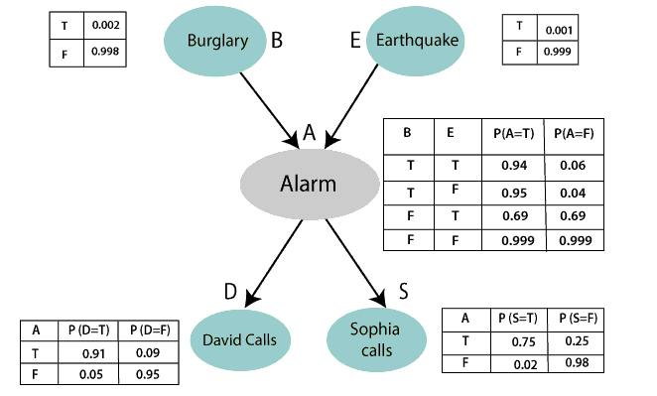

Slide 95
From the formula of joint distribution, we can write the problem statement in the form of probability distribution:
P(S, D, A, ¬B, ¬E) = P (S|A) *P (D|A)*P (A|¬B ^ ¬E) *P (¬B) *P (¬E).
  = 0.75* 0.91* 0.001* 0.998*0.999
  = 0.00068045.
Hence, a Bayesian network can answer any query about the domain by using Joint distribution.
The semantics of Bayesian Network:
There are two ways to understand the semantics of the Bayesian network, which is given below:
1. To understand the network as the representation of the Joint probability distribution. (It is helpful to understand how to construct the network.)
2. To understand the network as an encoding of a collection of conditional independence statements. (It is helpful in designing inference procedure.)

Slide 96
Probabilistic reasoning
Probabilistic reasoning is a way of knowledge representation where we apply the concept of probability to indicate the uncertainty in knowledge.
In probabilistic reasoning, we combine probability theory with logic to handle the uncertainty.
We use probability in probabilistic reasoning because it provides a way to handle the uncertainty that is the result of someone's laziness and ignorance.
In the real world, there are lots of scenarios, where the certainty of something is not confirmed, such as "It will rain today," here we can assume that it will happen but not sure about it, so here we use probabilistic reasoning.

Slide 97
Probabilistic Reasoning over Time
The world changes; we need to track and predict it.
Basic idea: copy state and evidence variables for each time step
  Xt = set of unobservable state variables at time t
  Et = set of observable evidence variables at time t
This assumes discrete time; step size depends on problem
  Notation: Xa:b = Xa,Xa+1, . . . ,Xb−1,Xb

Slide 98
Need of probabilistic reasoning in AI:
  When there are unpredictable outcomes.
  When specifications or possibilities of predicates becomes too large to handle.
  When an unknown error occurs during an experiment.
In probabilistic reasoning, there are two ways to solve problems with uncertain knowledge:
  Bayes' rule
  Bayesian Statistics

Slide 99
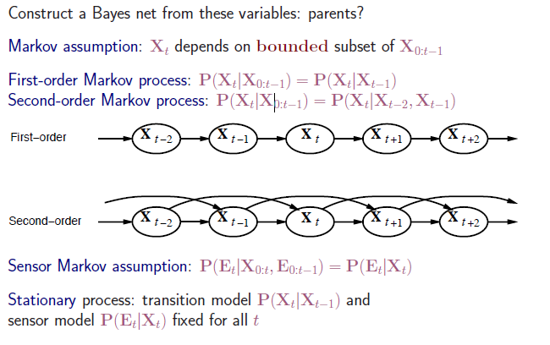
Markov processes (Markov chains)

Slide 100
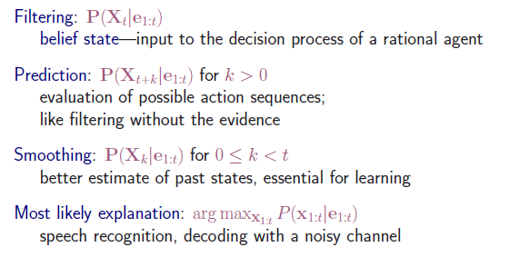
Inference tasks

Slide 101
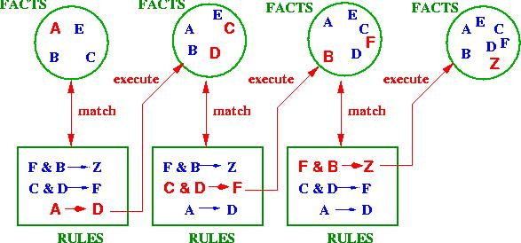
Forward and backward reasoning
Forward chaining or data-driven inference works from an initial state, and by looking at the premises of the rules (IF-part), perform the actions (THEN-part), possibly updating the knowledge base or working memory.
This continues until no more rules can be applied or some cycle limit is met, e.g.

Slide 102
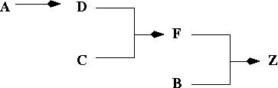
In example: no more rules, that is, inference chain for this is:
Problem with forward chaining:
many rules may be applicable. The whole process is not directed towards a goal.

Slide 103
Backward chaining or goal-driven inference works towards a final state, and by looking at the working memory to see if goal already there. If not look at the actions (THEN-parts) of rules that will establish goal, and set up subgoals for achieving premises of the rules (IF-part).
This continues until some rule can be applied, apply to achieve goal state.
Advantage of backward chaining:
search is directed
Disadvantage of backward chaining:
goal has to be known

Slide 104
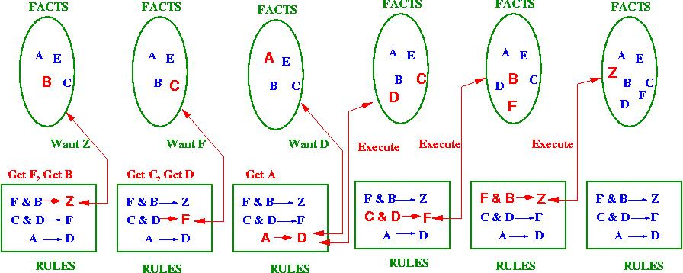

Slide 105
Other uncertainity techniques
Data mining
Fuzzy logic
Dempster -shafer theory

